Slide 1
Unboxing Microsoft Fabric
Tom Martens @ Power Platform and Microsoft Fabric Usergroup Cologne
2024-11-12

Slide 2
Inside the box
Who I am
Understanding (What is Microsoft Fabric=
Architecting (the medallion thingy)
Computing data
Ingesting data
Choosing the “perfect” fit
Resources

Slide 3

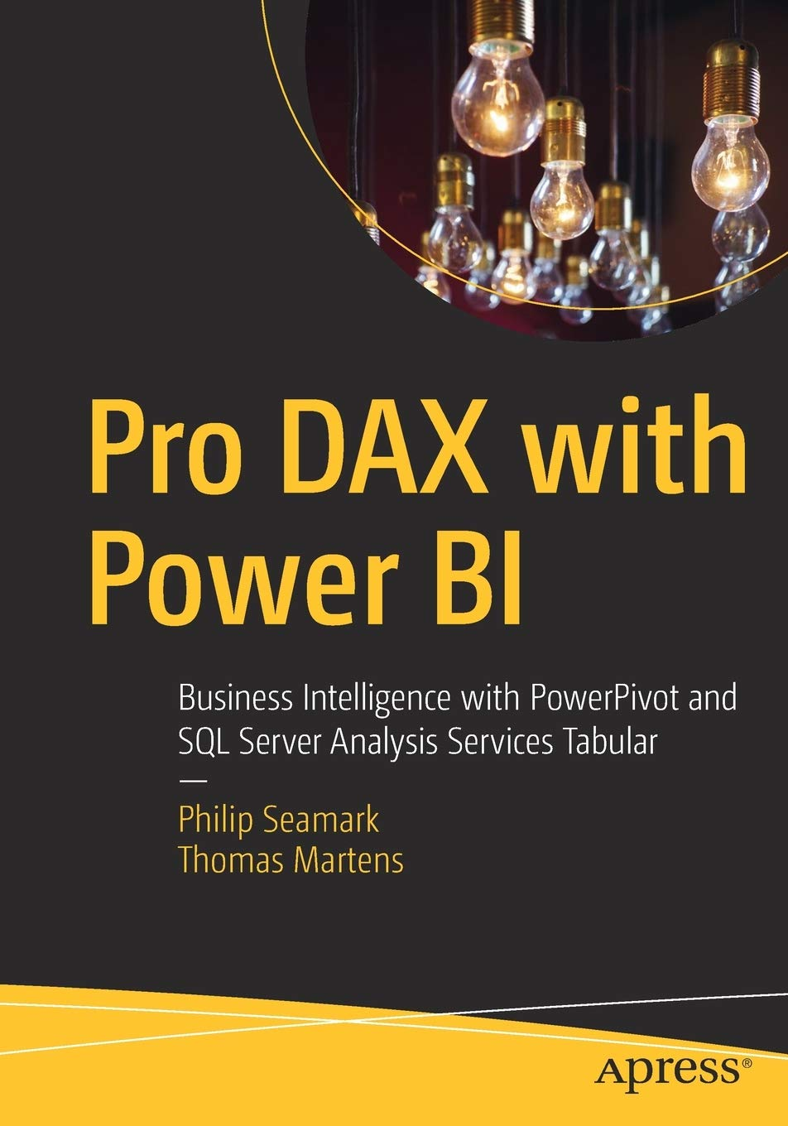
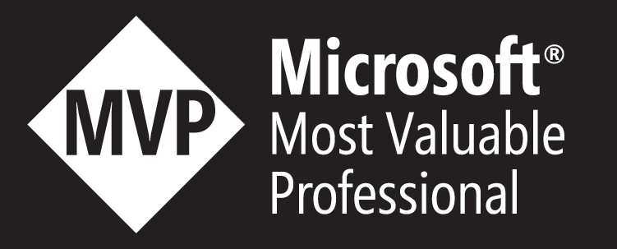
Tom Martens
25+ years of experience designing analytical solutions using the MSFT data platform
Solution Architect @ Munich Re
/tommartens68
@tommartens68

Slide 4

What is Microsoft Fabric – under the hood?

Slide 5

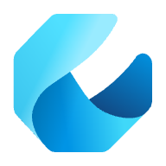
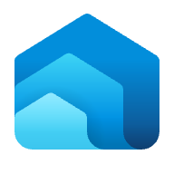
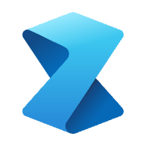

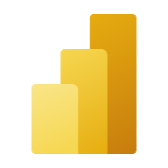


The unified analytics platform
Data
Factory
Synapse Data
Engineering
Synapse Data Warehouse
Synapse Data Science
Synapse Real Time Analytics
Power BI
Data Activator (coming soon)
OneLake
Lake centric and open
Empower every Office user
Pervasive security and governance

Slide 6
Microsoft Fabric – under the hood (a gentle glimpse)
The most common analytical workloads
Synapse Data Warehousing
Synapse Data
Engineering
Data
Factory
Synapse Data
Science
Synapse Real
Time Analytics
Power BI

Slide 7
Microsoft Fabric – under the hood (a gentle glimpse)
Separating the storage from the compute
Synapse Data Warehousing
Synapse Data
Engineering
Data
Factory
Synapse Data
Science
Synapse Real
Time Analytics
Power BI
Serverless
Compute
T-SQL
Spark
KQL
Analysis Services
Warehouse
Lakehouse
Kusto DB
Dataset
Storage

Slide 8
Microsoft Fabric – under the hood (a gentle glimpse)
Unified storage (Delta Parquet Format)
Delta Lake is the open table storage format that Microsoft Fabric has standardized on, supporting capabilities like ACID transactions, time travel, schema evolution and more.
Delta Lake enables ‘OneCopy’ allowing all Microsoft Fabric compute engines to seamlessly share data
All Microsoft Fabric artifacts automatically write Delta with V-Order optimization providing lightning-fast analytics on Vertiscan for reporting with Power BI
‘Load to Delta’ in the lakehouse unlocks a visual experience to load common file formats and folders to Delta
Synapse Data Warehousing
Synapse Data
Engineering
Data
Factory
Synapse Data
Science
Synapse Real
Time Analytics
Power BI
Serverless
Compute
T-SQL
Spark
KQL
Analysis Services
Warehouse
Lakehouse
Kusto DB
Dataset
Delta – Parquet Format
Delta – Parquet Format
OneLake
Delta – Parquet Format
Delta – Parquet Format

Slide 9

A Single Unified SaaS Data Lake
Data
Warehousing
Data
Engineering
Data Integration
Data
Science
Real
Time
Analytics
Business Intelligence
OneLake comes automatically provisioned with every Fabric tenant with no infrastructure to manage.
Unified Management and Governance
Any data in OneLake works with out of the box governance such as data linage, data protection, certification, catalog integration, etc. All data is ultimately under the control of a tenant admin.
OneLake
Workspace
POS Sales
Workspace Online Sales
Workspace
Customer
Workspace
Ads
Workspace
Expenses
OneLake enables distributed ownership. Different workspaces allow different parts of the organization to work independently while still contributing to the same data lake. Each workspace can have its own administrator, access control, region and capacity for billing
Notes:
What this means that for every Trident tenant, you will always have exactly one OneLake. Never two, never 0. There is no infrastructure to setup or manage.
The concept of a tenant is a unique benefit of a SaaS service. It allows us to automatically provide a single management and governance boundary for an entire organization which is ultimately under the control of a tenant admin. The admin sets this initial boundary and any data which lands in OneLake will automatically take part in out of the box data governance such as data linage, data protection, certification, catalog integration, etc. All data is ultimately under the control of a tenant admin. However, it is important that different business groups are able to work independently without going through a central gatekeeper. An Office user does not need to coordinate with their Office admin to create a new Teams channel or SharePoint site.
OneLake enables distributed ownership through workspaces. Different workspaces allow different parts of the organization to work independently while still contributing to the same data lake. Each workspace can have its own administrator, access control, region and capacity for billing. Creating a workspace is very lightweight. It inherits the rules set by the tenant admin so there if no need to reimplement the same governance or spend time trying to get different resources to talk to each other. Workspace admins can further control access to the data within their workspace as needed.

Slide 10
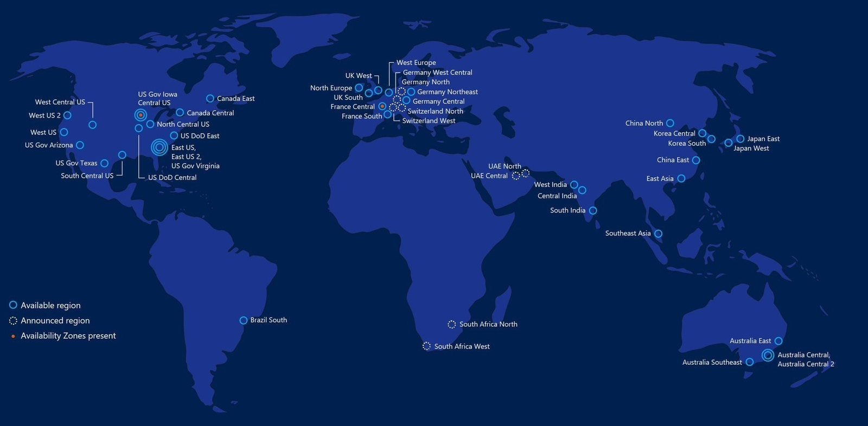
OneLake which logically spans the world
Unified Management and Governance
OneLake
Workspaces can reside in different regions around the world while still being part of the same data lake.
Workspace
POS Sales
Workspace Online Sales
Workspace
Customer
Workspace
Ads
Workspace
Expenses
Notes:
You might be thinking that your organization can’t have just one lake because you are in multiple countries, and you have requirements that data must reside in those countries. OneLake covers this this by spanning the globe as well. Different workspace can reside in different regions. This means that any data in those workspaces will also reside in those countries. OneLake is built on top of Azure Data Lake Store gen2. Under the covers, it may use multiple storage accounts in different regions however, OneLake will virtualize them into one logical lake.

Slide 11


OneLake for all domains
Data
Warehousing
Data
Engineering
Data Integration
Data
Science
Real
Time
Analytics
Business Intelligence
A domain is a way of logically grouping together all the data in an organization that is relevant to an
area or field.
Domains are defined with domain admins and contributors who can logically group together workspaces under those domains.
Unified Management and Governance
OneLake
Sales
Marketing
Finance
Domains provide a management boundary between tenant and workspace enabling domain admins to have more granular control over multiple workspaces.
Certified
Certified
Promoted
Workspace
POS Sales
Workspace Online Sales
Workspace
Customer
Workspace
Ads
Workspace
Expenses
Domains simplify discovery and consumption of data across the organization.
Avoid data swamps by endorsing certain data as certified or promoted.
Notes:
Different business groups are now able to work independently within the same data lake without the overhead of managing different storage resources. They are already able to implement the popular data mesh pattern more efficiently than they could before. OneLake takes this even further with the introduction of domains as a first-class concept. A single business domain may have multiple workspaces as workspaces tend to align with specific projects or teams.
A domain is a way of logically grouping together all the data in and organization that is relevant to an area or field.
Domains are defined with domain admins and contributors who can logically group together workspaces under those domains..
Domains provide a management boundary between tenant and workspace enabling admins to have more granular control over multiple workspaces.
As you will see later, domains also simplify discovery and consumption of data across the entire organization. Now that we are making it so easy for different parts of the organization to work on the same data lake without going through a central gatekeeper, you might be thinking that you want to block certain users from adding to the lake. If anyone can add to the data lake, then these can quickly become data swamps with data from official sources mixed with data from unofficial sources. The problem with blocking users from OneLake, is that they will just create another data lake somewhere else. When they do that, you will have no idea if that data is properly governed or even how it is being used. If they add their data to OneLake, it will be automatically governed and still under the control of the admins who will start to get more and more insights on how that data is being used.
You can avoid data swamps in OneLake through data endorsements. Domain owners can officially certify data or recommend data so that the important data rises to the surface while the rest sinks to the bottom.

Slide 12

Medallion Architecture

Slide 13



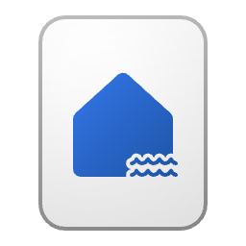
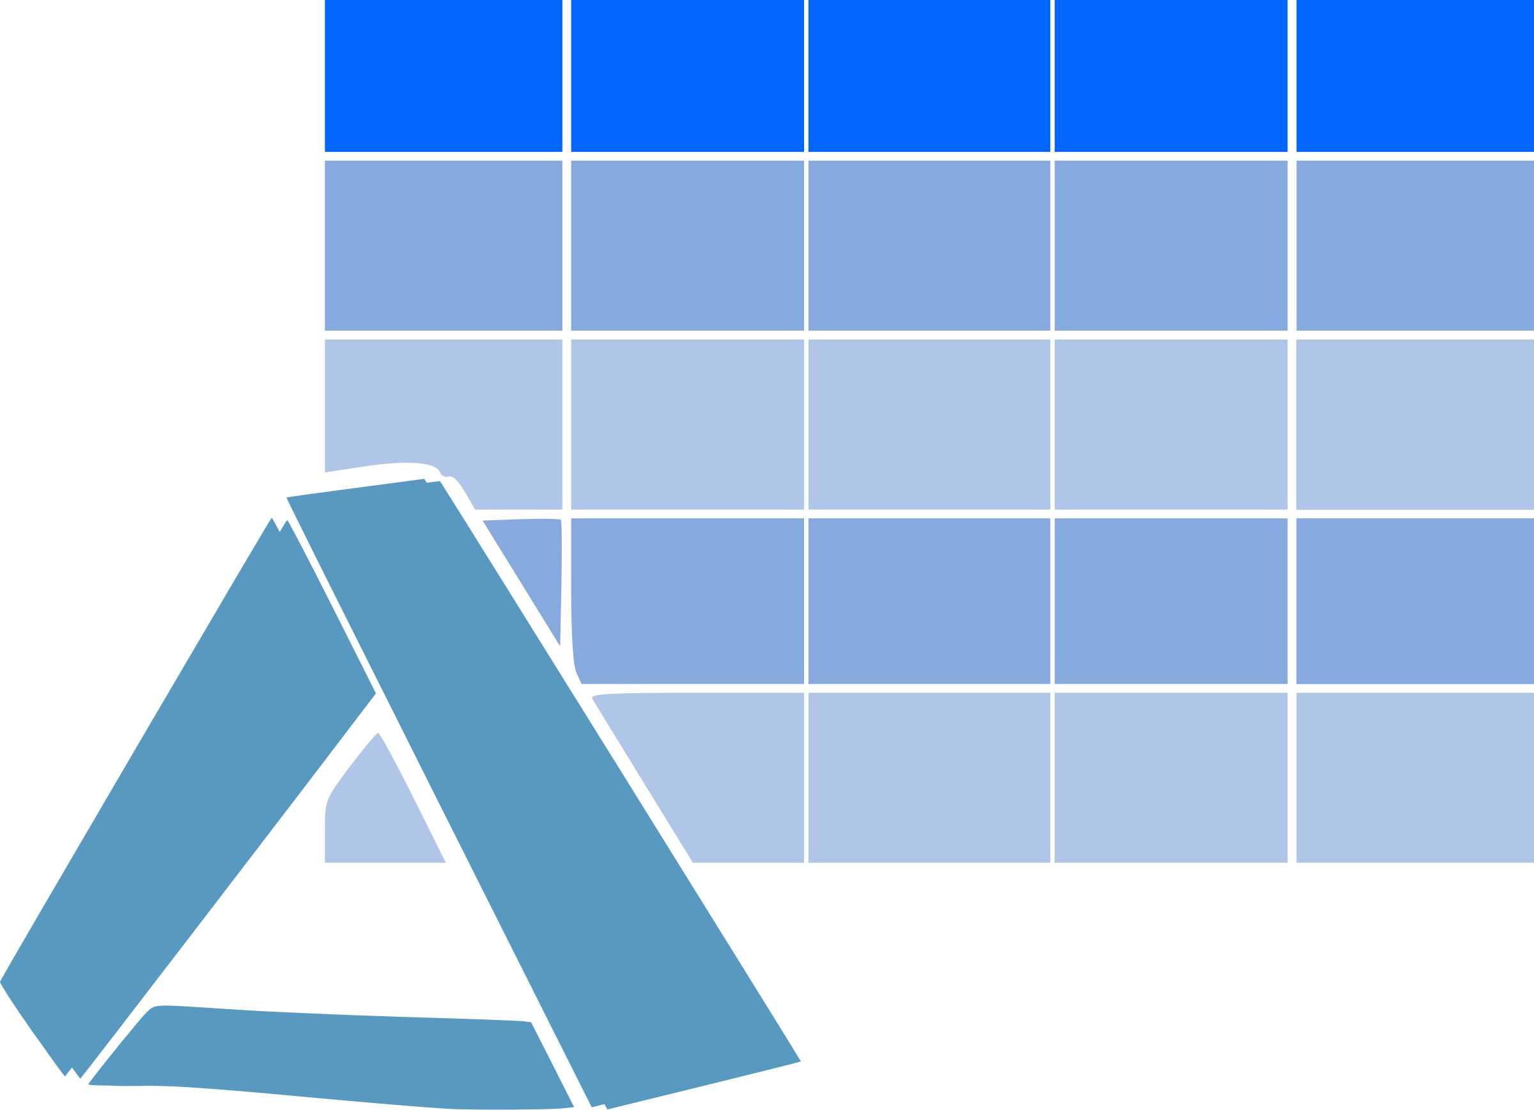
Architecting - the medallion approach
Bronze Layer
Get all the data
Silver Layer
Creating structure
Gold Layer
Harvesting insights
Any format

Slide 14

Bronze layer
The bronze or raw layer of the medallion architecture is the first layer of the lakehouse.
Consider the Bronze layer being the landing zone for all your data, data is stored in the original format and structure.
Of course, data ingestion can be more challenging than in this example; as always, it depends. The amount of data, the frequency of new data arrival, and the complexity of the data type have to be considered.
File upload
Bronze Layer
Get all the data
Any format
Notes:
The bronze or raw layer of the medallion architecture is the first layer of the lakehouse. It's the landing zone for all data, whether it's structured, semi-structured, or unstructured. The data is stored in its original format, and no changes are made to it.

Slide 15
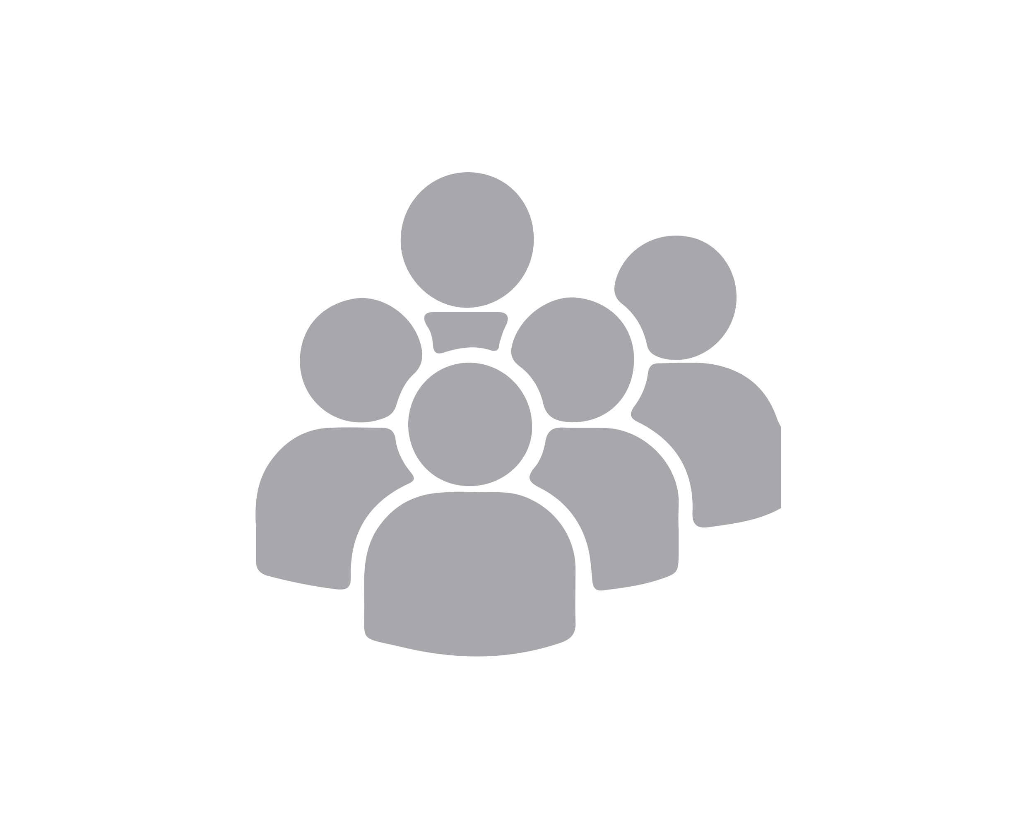

Silver layer
The silver or validated layer is the second layer of the lakehouse.
Typical activities in the silver layer include combining and merging data and enforcing data validation rules like removing nulls:
df = df.withColumn("CustomerName", when((col("CustomerName").isNull() …
Bronze Layer
Get all the data
Providing structure
Silver Layer
Creating structure
Next to data validation/cleansing, adding “housekeeping columns” is done in the Silver layer as the name of the CSV file.
The Silver Layer is used by Teams and across the organization and can be considered as a data repository
The Data Engineering Team
Notes:
The silver or validated layer is the second layer of the lakehouse. It's where you'll validate and refine your data. Typical activities in the silver layer include combining and merging data and enforcing data validation rules like removing nulls and deduplicating. The silver layer can be thought of as a central repository across an organization or team, where data is stored in a consistent format and can be accessed by multiple teams. In the silver layer you're cleaning your data enough so that everything is in one place and ready to be refined and modeled in the gold layer.

Slide 16

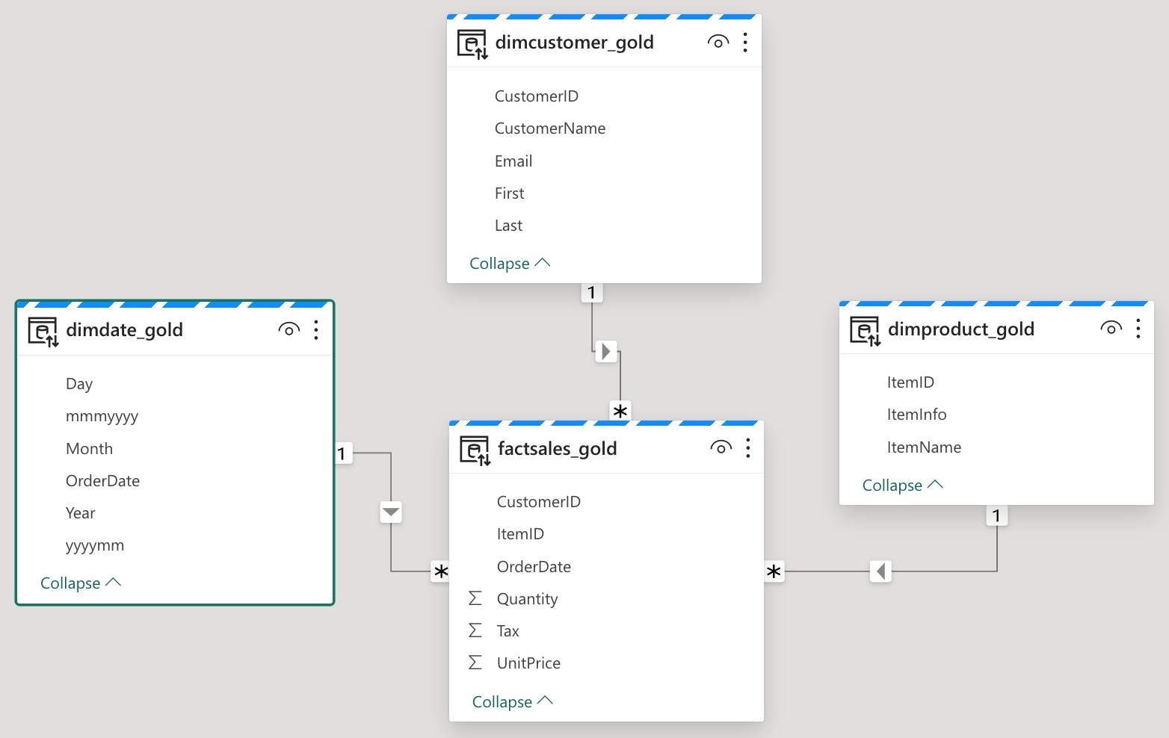
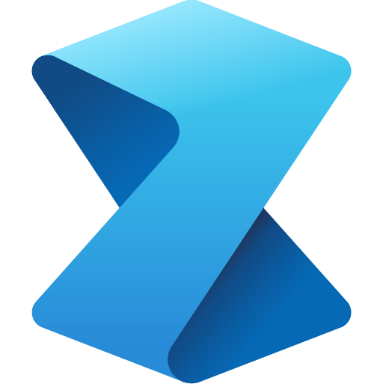
Gold layer
Data is further refined in the gold layer, ready for downstream use like semantic models in Power BI or Data Science workloads.
Refinement and enrichment
Gold Layer
Harvesting insights
Silver Layer
Creating structure
Notes:
The gold or enriched layer is the third layer of the lakehouse. In the gold layer, data undergoes further refinement to align with specific business and analytics needs. This could involve aggregating data to a particular granularity, such as daily or hourly, or enriching it with external information. Once the data reaches the gold stage, it becomes ready for use by downstream teams, including analytics, data science, or MLOps.

Slide 17
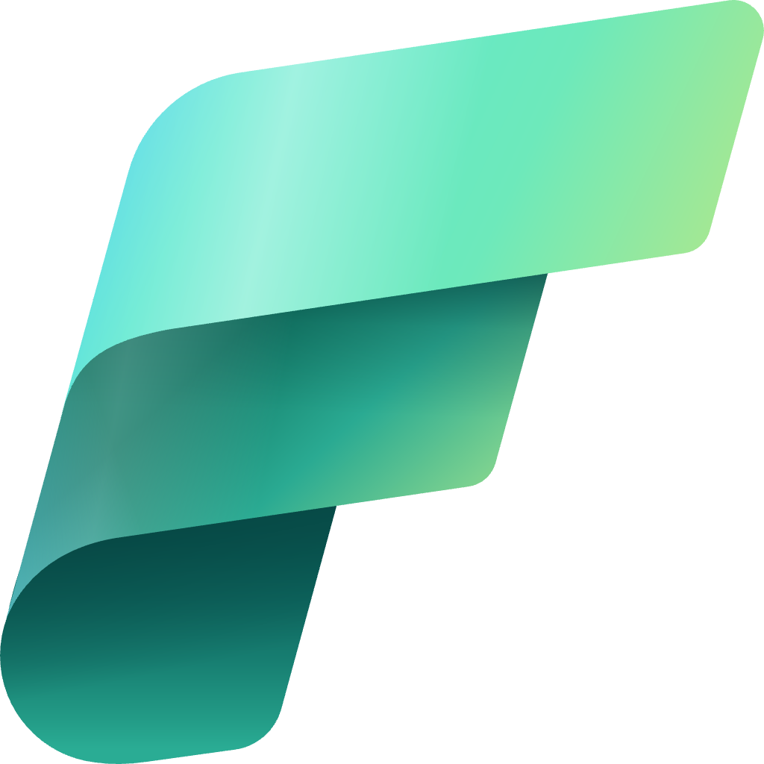
Customize your medallion architecture
Depending on your organization's specific use case, you may have a need for more layers or think about spreading the layers across workspace.
Gold Layer
Harvesting insights
Bronze
Silver
Gold
Silver Layer
Creating structure
Bronze Layer
Get all the data
A larger Fabric capacity
A smaller Fabric capacity
Raw Layer
Notes:
Depending on your organization's specific use case, you may have a need for more layers. For example, you might have an additional "raw" layer for landing data in a specific format before it's transformed into the bronze layer. Or you might have a "platinum" layer for data that's been further refined and enriched for a specific use case. Regardless of the names and number of layers, the medallion architecture is flexible and can be tailored to meet your organization's particular requirements.

Slide 18
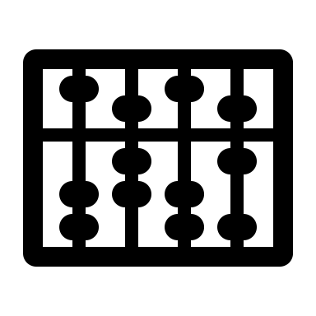
Compute

Slide 19
Computing data with Microsoft Fabric (a gentle glimpse)
Synapse Data Warehousing
Synapse Data
Engineering
Data
Factory
Synapse Data
Science
Synapse Real
Time Analytics
Power BI
Serverless
Compute
T-SQL
Spark
KQL
Analysis Services
Warehouse
Lakehouse
Kusto DB
Dataset
Delta – Parquet Format
Delta – Parquet Format
OneLake
Delta – Parquet Format
Delta – Parquet Format

Slide 20
Computing data with Microsoft Fabric (a gentle glimpse)
Language: T-SQL
Data types: structured
Specific Features: Multi-table transactions, Collations
Polaris
Synapse Data Warehousing
Spark
Language: Spark SQL, Python, Scala
Data Types: structured, semi-structured, unstructured, Spark streaming
Synapse Data
Engineering
Data Explorer (Kusto)
Language: KQL
Data Types: streaming, time series
Synapse Real
Time Analytics
Language: DAX
Data Types: Tabular model
Specific features: Measures
Analysis Services
Power BI

Slide 21
Computing data with Microsoft Fabric (a gentle glimpse)
What is your data strategy?
What are you architecting for?
But the most important questions you have to answer: What is your data maturity and what skills do you own?
Language: T-SQL
Data types: structured
Specific Features: Multi-table transactions, Collations
Polaris
Synapse Data Warehousing
Spark
Language: Spark SQL, Python, Scala
Data Types: structured, semi-structured, unstructured, Spark streaming
Synapse Data
Engineering
Data Explorer (Kusto)
Language: KQL
Data Types: streaming, time series
Synapse Real
Time Analytics
Language: DAX
Data Types: Tabular model
Specific features: Measures
Analysis Services
Power BI

Slide 22


Ingest

Slide 23
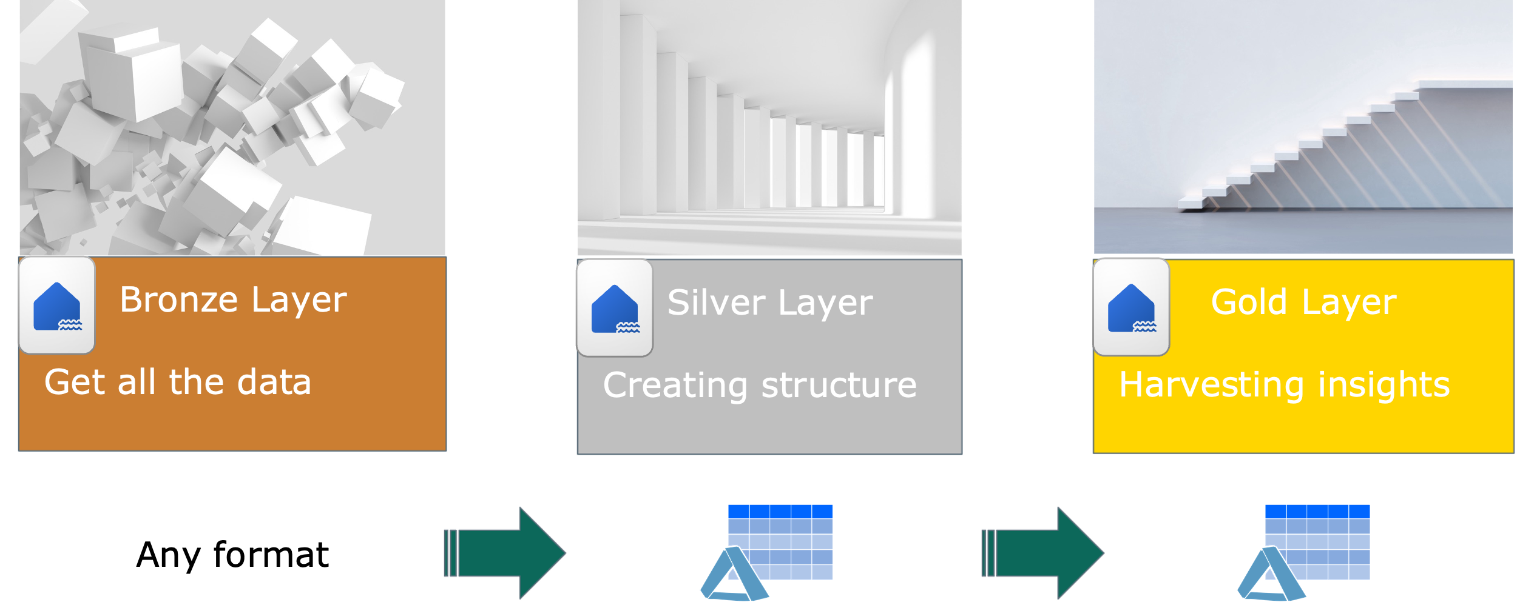






Ingesting data with Microsoft Fabric (a gentle glimpse, be aware that I omitted streaming data in this glimpse)
More Citizen
Shortcuts
Dataflow Gen 2
Data Pipeline
Notebook
More Developer
Spark Job

Slide 24
Ingesting data with Microsoft Fabric (a gentle glimpse, be aware that I omitted streaming data in this glimpse)
Language: T-SQL
Data types: structured
Specific Features: Multi-table transactions, Collations
Polaris
Synapse Data Warehousing
Spark
Language: Spark SQL, Python, Scala
Data Types: structured, semi-structured, unstructured, Spark streaming
Synapse Data
Engineering

Slide 25
Ingesting data with Microsoft Fabric (a gentle glimpse, be aware that I omitted streaming data in this glimpse)
More Citizen
Shortcuts
Polaris
Synapse Data Warehousing
Dataflow Gen 2
Data Pipeline
Notebook
Spark
More Developer
Synapse Data
Engineering
Spark Job

Slide 26
Ingesting data with Microsoft Fabric (a gentle glimpse, be aware that I omitted streaming data in this glimpse)
More Citizen
Shortcuts
Polaris
Synapse Data Warehousing
Dataflow Gen 2
Data Pipeline
Notebook
Spark
More Developer
Synapse Data
Engineering
Spark Job

Slide 27
Ingesting data with Microsoft Fabric (a gentle glimpse, be aware that I omitted streaming data in this glimpse)
More Citizen
Shortcuts
Polaris
Synapse Data Warehousing
Dataflow Gen 2
Data Pipeline
Notebook
Spark
More Developer
Synapse Data
Engineering
Spark Job

Slide 28
Ingesting data with Microsoft Fabric (a gentle glimpse, be aware that I omitted streaming data in this glimpse)
More Citizen
Shortcuts
Polaris
Synapse Data Warehousing
Dataflow Gen 2
Data Pipeline
Notebook
Spark
More Developer
Synapse Data
Engineering
Spark Job

Slide 29
Ingesting data with Microsoft Fabric (a gentle glimpse, be aware that I omitted streaming data in this glimpse)
More Citizen
Shortcuts
Polaris
Synapse Data Warehousing
Dataflow Gen 2
Data Pipeline
Notebook
Spark
More Developer
Synapse Data
Engineering
Spark Job

Slide 30
Ingesting data with Microsoft Fabric (a gentle glimpse, be aware that I omitted streaming data in this glimpse)
Orchestration
More Citizen
Shortcuts
Polaris
Synapse Data Warehousing
Dataflow Gen 2
Data Pipeline
Notebook
Spark
More Developer
Synapse Data
Engineering
Spark Job

Slide 31
Ingesting data with Microsoft Fabric (a gentle glimpse, be aware that I omitted streaming data in this glimpse)
Orchestration
Polaris
Synapse Data Warehousing
Spark
Synapse Data
Engineering
More Citizen
Shortcuts
Dataflow Gen 2
Data Pipeline
Notebook
Analysis Services
More Developer
Spark Job
Power BI

Slide 32

Additional Considerations for choosing the perfect fit?

Slide 33
Additional Considerations for choosing the “perfect” fit
How much data are you working with today, tomorrow, and the day after tomorrow?
How complex are the transformations you need to make?
How often will you need to move data between layers?
What tools are you most comfortable with?
Notes:
Moving data across medallion layers refines, organizes, and prepares it for downstream data activities. Within Fabric's lakehouse, there's more than one way to move data between layers, ensuring that you can choose the method that works for your team.
There are a few things to consider when deciding how to move and transform data across layers.
How much data are you working with?
How complex are the transformations you need to make?
How often will you need to move data between layers?
What tools are you most comfortable with?
Understanding the difference between data transformation and data orchestration helps you select the right tools for the job within Fabric.
Data transformation involves altering the structure or content of data to meet specific requirements. Tools for data transformation in Fabric include Dataflows (Gen2) and notebooks. Dataflows are a great option for smaller datasets and simple transformations. Notebooks are a better option for larger datasets and more complex transformations. Notebooks also allow you to save your transformed data as a managed Delta table in the lakehouse, ready for reporting.
Data orchestration refers to the coordination and management of multiple data-related processes, ensuring they work together to achieve a desired outcome. The primary tool for data orchestration in Fabric is pipelines. A pipeline is a series of steps that move data from one place to another, in this case, from one layer of the medallion architecture to the next. Pipelines can be automated to run on a schedule or triggered by an event.

Slide 34
Resources
The Polaris whitepaper: https://www.vldb.org/pvldb/vol13/p3204-saborit.pdf

Slide 35
Thank you
/tommartens68
@tommartens68

